Slide 1

Healthcare analytics

Slide 2
What Is Healthcare Analytics?
Healthcare analytics is the process of analyzing current and historical industry data to predict trends, improve outreach, and even better manage the spread of diseases.
It can reveal paths to improvement in patient care quality, clinical data, diagnosis, and business management.

Slide 3
Application of healthcare analytics
Management and reporting of health records
Prediction of expenditure
Detection of disease
Prediction of insurance charges
Prediction of type of disease
Prediction of survival
Prediction of tumor location

Slide 4
Electronic health records
Electronic health records (EHRs) contain a digitized version of a patient’s medical history.
It encompasses a full range of data relevant to a patient’s care such as demographics, problems, medications, physician’s observations, vital signs, medical history, laboratory data, radiology reports, progress notes, and billing data.
Many EHRs go beyond a patient’s medical or treatment history and may contain additional broader perspectives of a patient’s care.

Slide 5
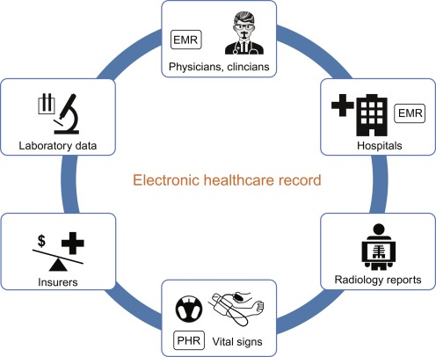

Slide 6
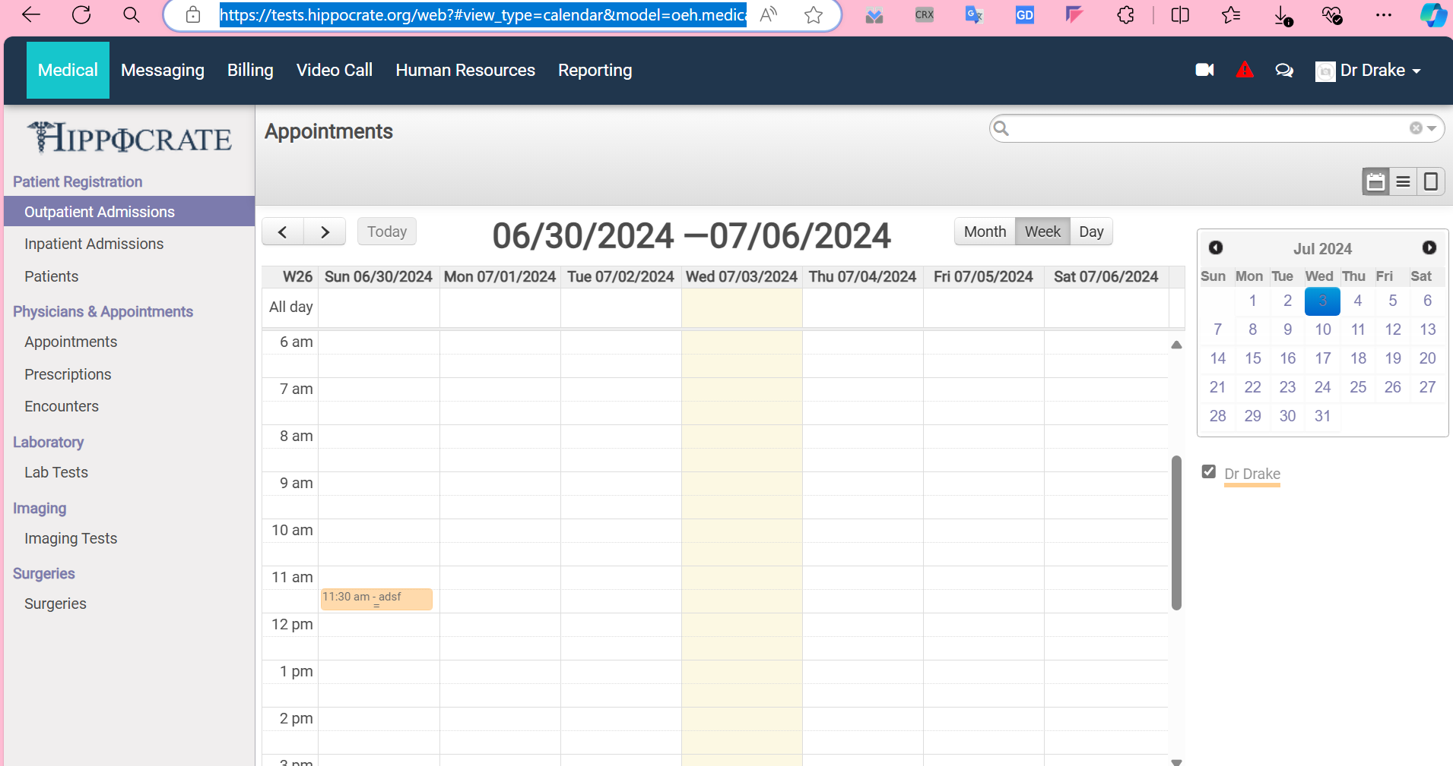
Appointments (hippocrate.org)

Slide 7
Components of EHR systems
Patient management
Clinical Component
Secure messaging and alert
Financial dashboard
Revenue tracking system

Slide 8
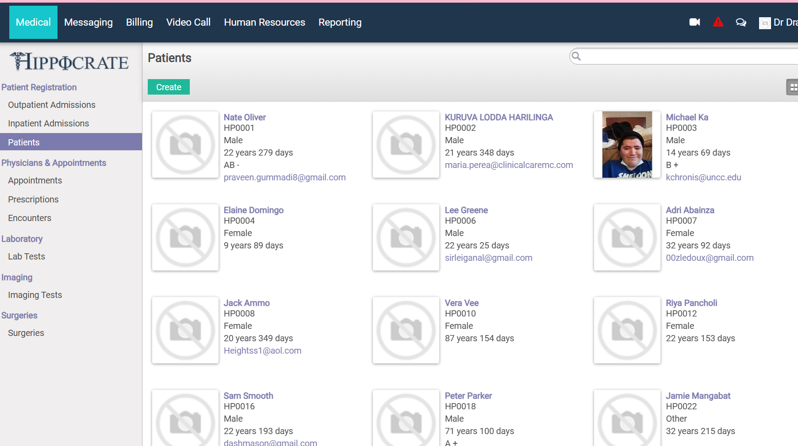

Slide 9
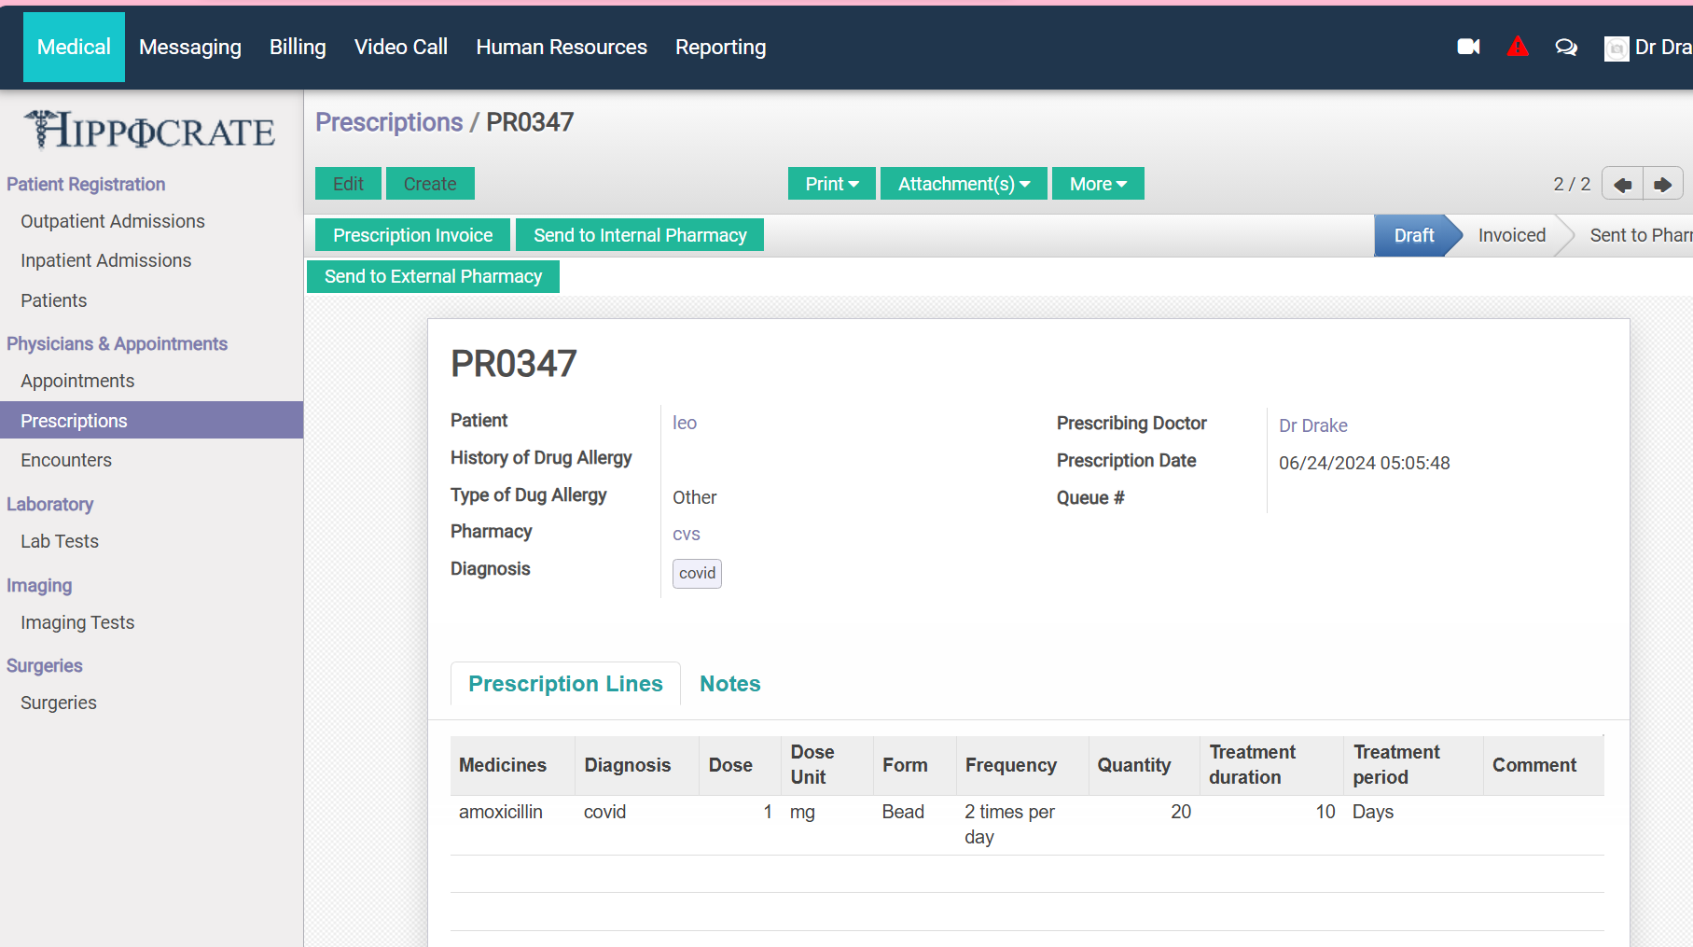

Slide 10
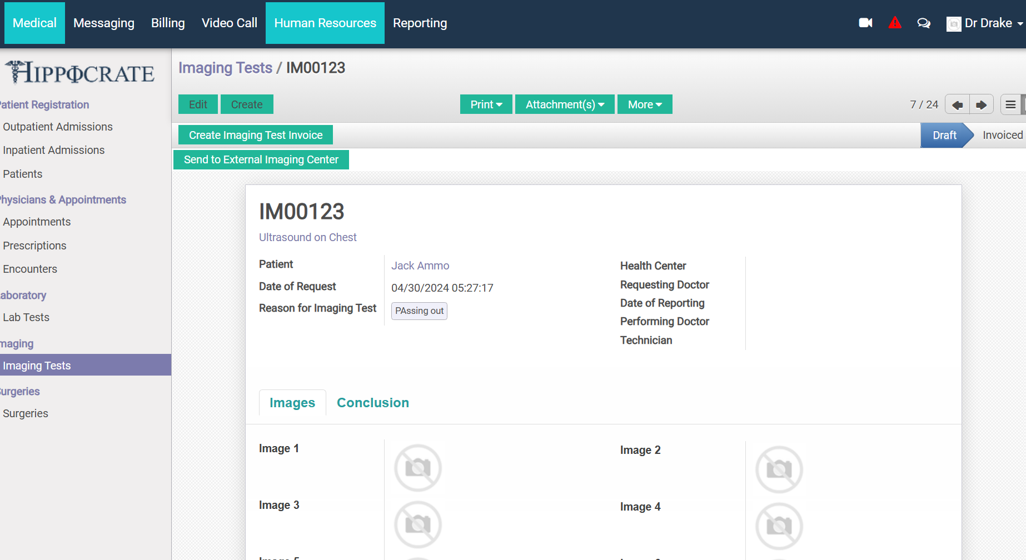
Storing biomedical images

Slide 11
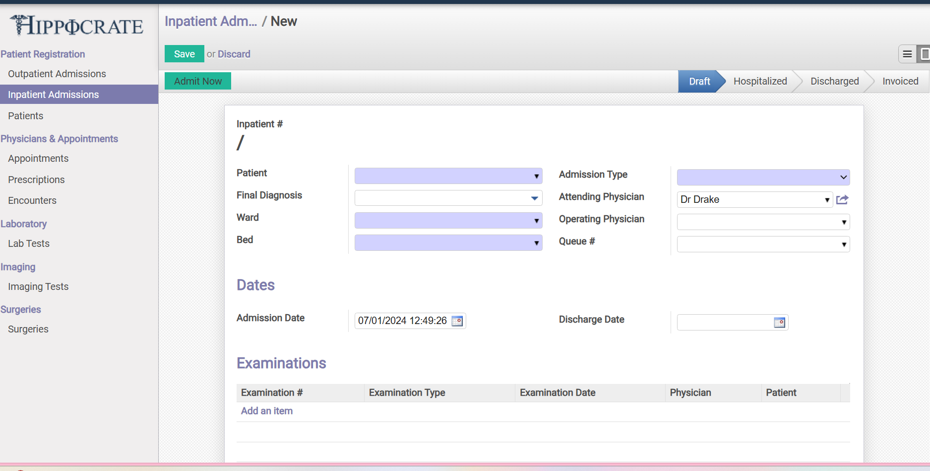
Admitting a patient

Slide 12
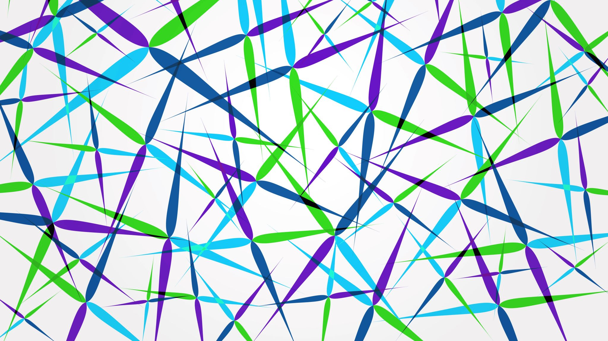
Introduction to machine learning
Indrani Sen , MCA, Mphil Computer Science

Slide 13
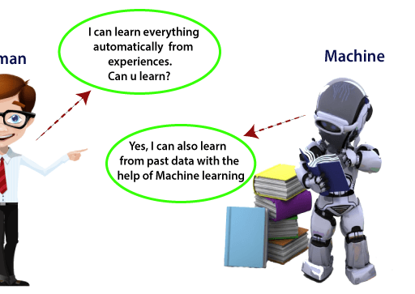
What is machine learning?
Machine learning is a technique by which the system learns to perform a certain task with the help of a learning algorithm which generates new rules based on the training data it is fed with.
This means computers can be used for new, complicated tasks that could not be manually programmed.

Slide 14
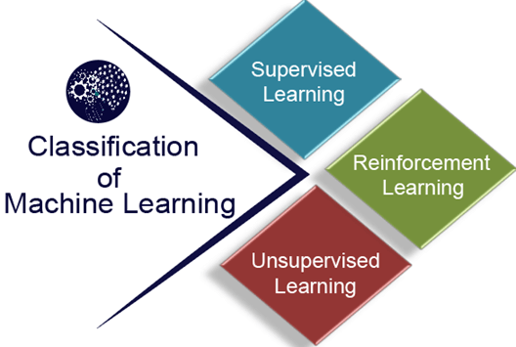
Types of Machine Learning
Machine learning algorithms can be primarily divided into two categories.
Supervised machine learning algorithms
Unsupervised machine learning algorithms
Reinforcement learning

Slide 15
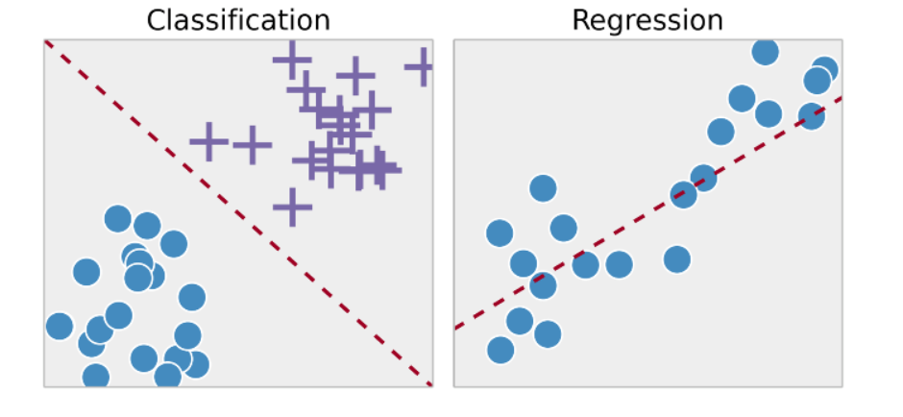
Why Supervised Learning?
Supervised learning allows you to collect data or produce a data output from the previous experience.
Helps you to optimize performance criteria using experience
Supervised machine learning helps you to solve various types of real-world computation problems.

Slide 16

Main techniques behind supervised learning are
Classification
Regression

Slide 17
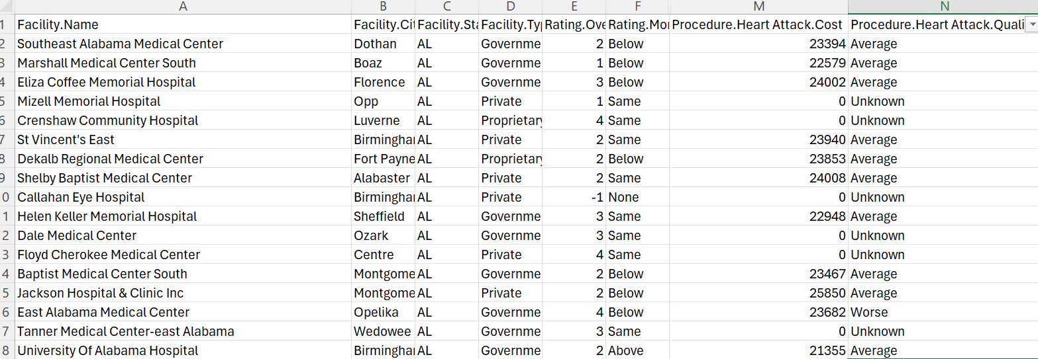

Slide 18
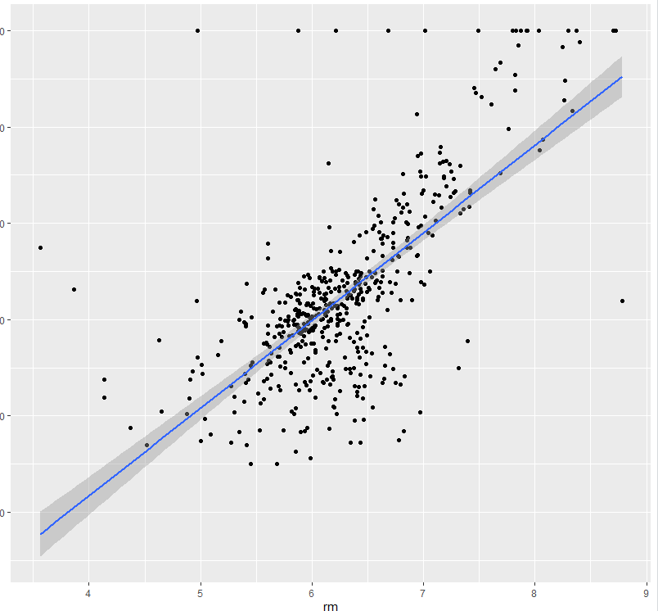
Regression line

Slide 19
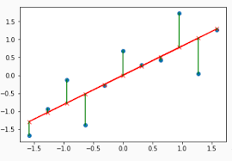
Minimise the residuals

Slide 20
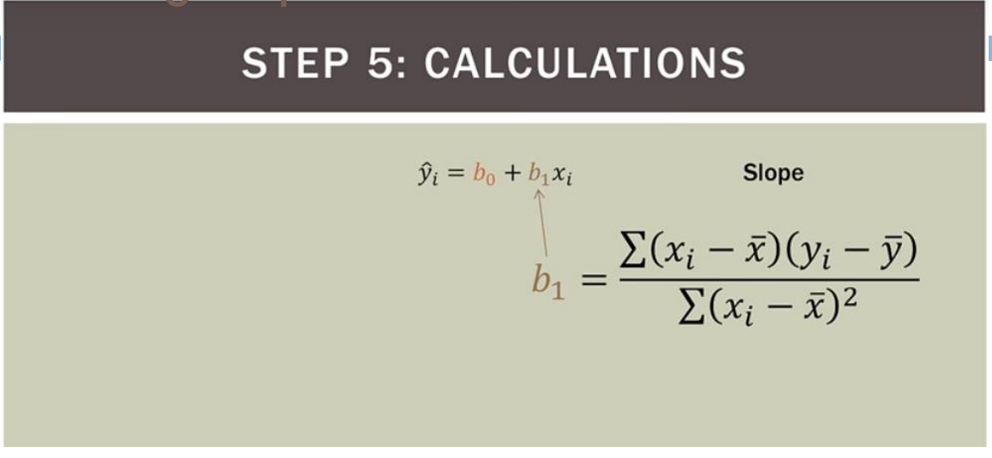
Calculating slope

Slide 21
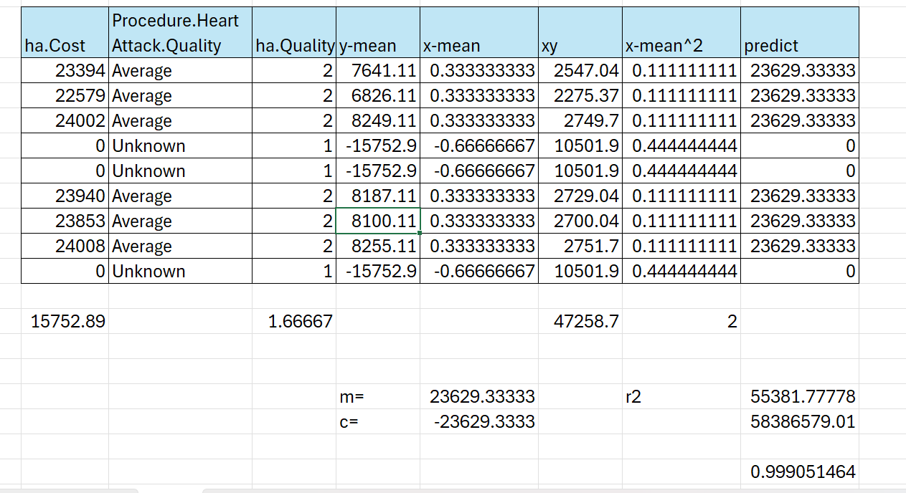

Slide 22
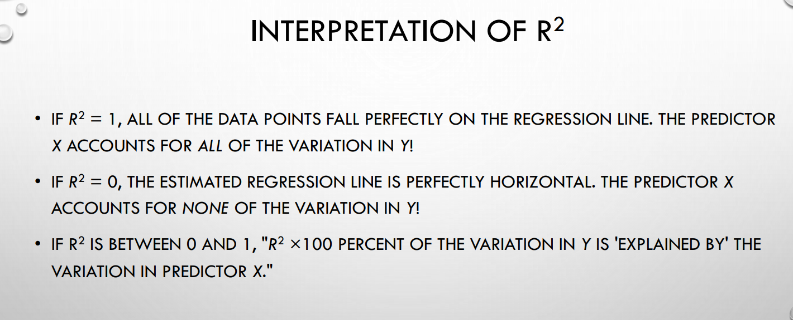
R square

Slide 23
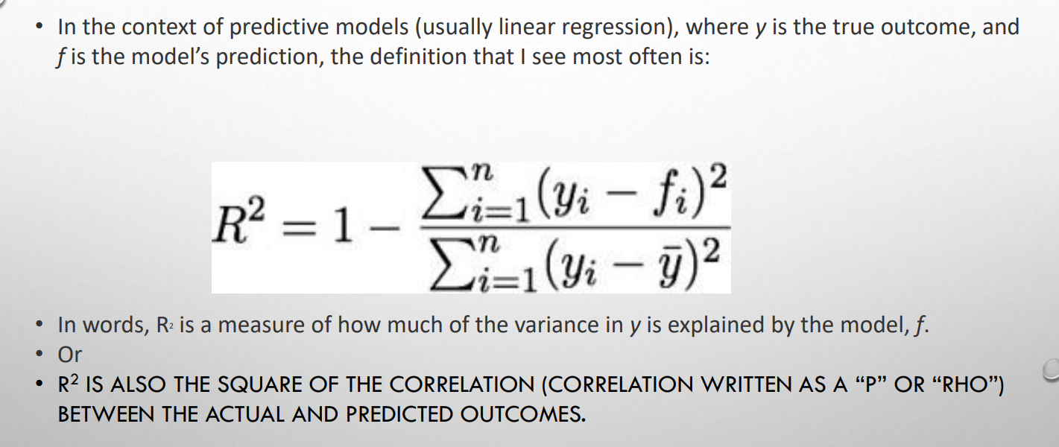
What is R square

Slide 24
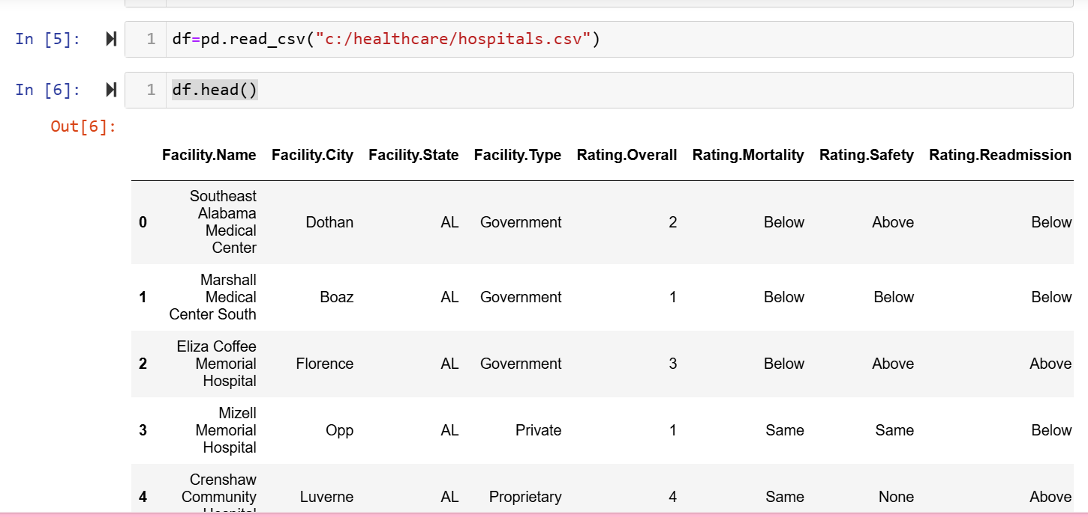

Slide 25
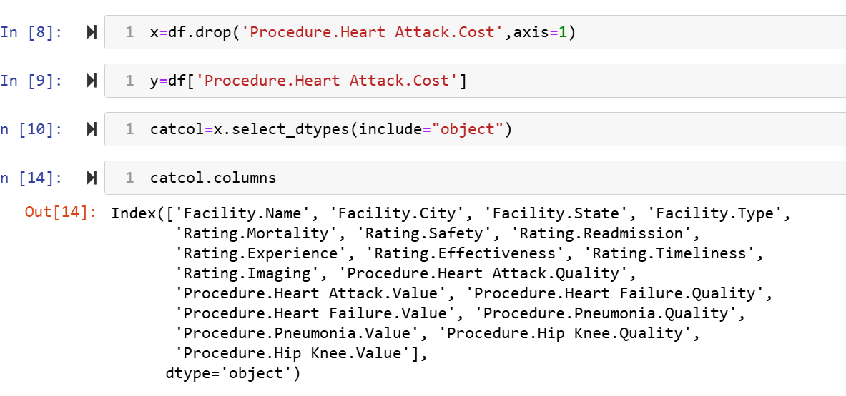
Dividing dataset into x and y

Slide 26
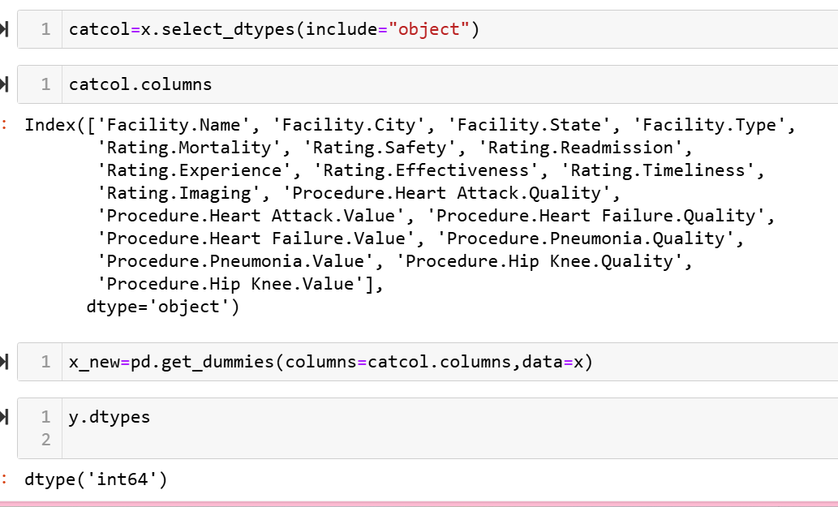
Encoding categorical columns

Slide 27
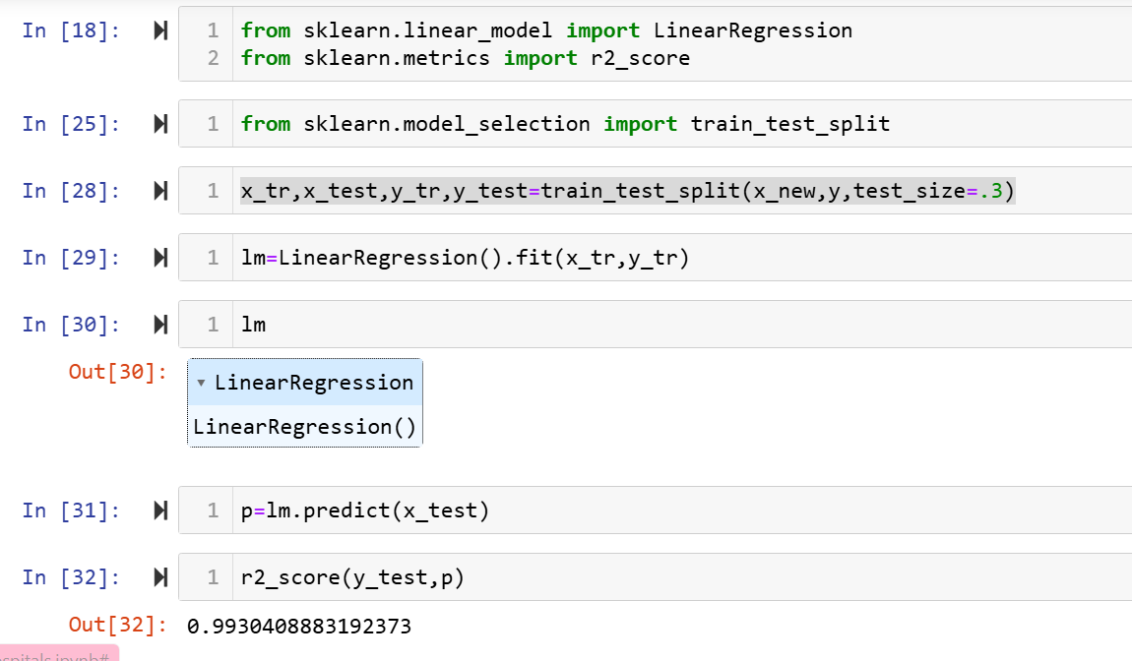
LinearRegression training and prediction

Slide 28
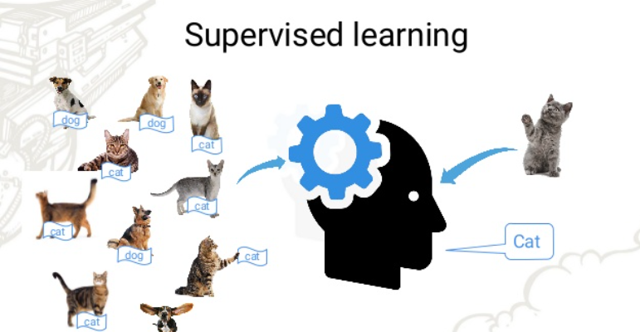
Classification

Slide 29
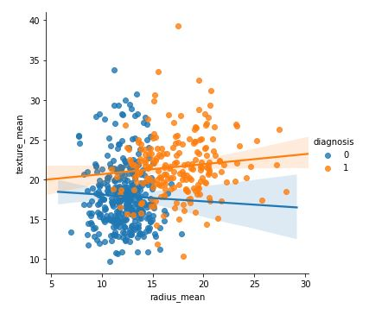
Cancer detection from tumor(classification)
id | diagnosis | radius_mean | texture_mean | perimeter_mean | area_mean | smoothness_mean
842302 | M | 17.99 | 10.38 | 122.8 | 1001 | 0.1184
842517 | M | 20.57 | 17.77 | 132.9 | 1326 | 0.08474
84610002 | M | 15.78 | 17.89 | 103.6 | 781 | 0.0971
846226 | M | 19.17 | 24.8 | 132.4 | 1123 | 0.0974
846381 | M | 15.85 | 23.95 | 103.7 | 782.7 | 0.08401
84667401 | M | 13.73 | 22.61 | 93.6 | 578.3 | 0.1131
84799002 | M | 14.54 | 27.54 | 96.73 | 658.8 | 0.1139
8510653 | B | 13.08 | 15.71 | 85.63 | 520 | 0.1075

Slide 30
What is Logistic Regression
Logistic Regression is part of a larger class of algorithms known as Generalized Linear Model (glm).
In 1972, Nelder and Wedderburn proposed this model with an effort to provide a means of using linear regression to the problems which were not directly suited for application of linear regression.

Slide 31
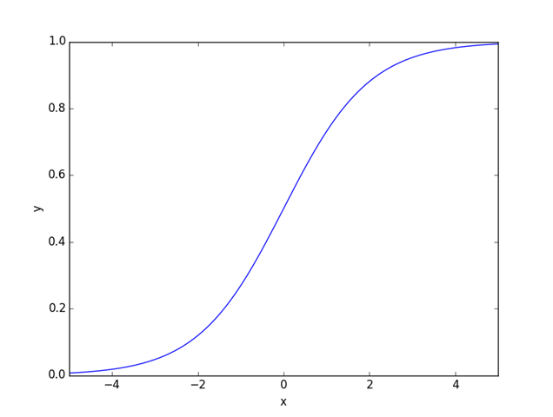
Sigmoid function
y= 1/(1 + exp(-x))
Where y is the target variable and x is the independent variable
In multiple linear regression x is replace by the linear regression equation also called link function.

Slide 32
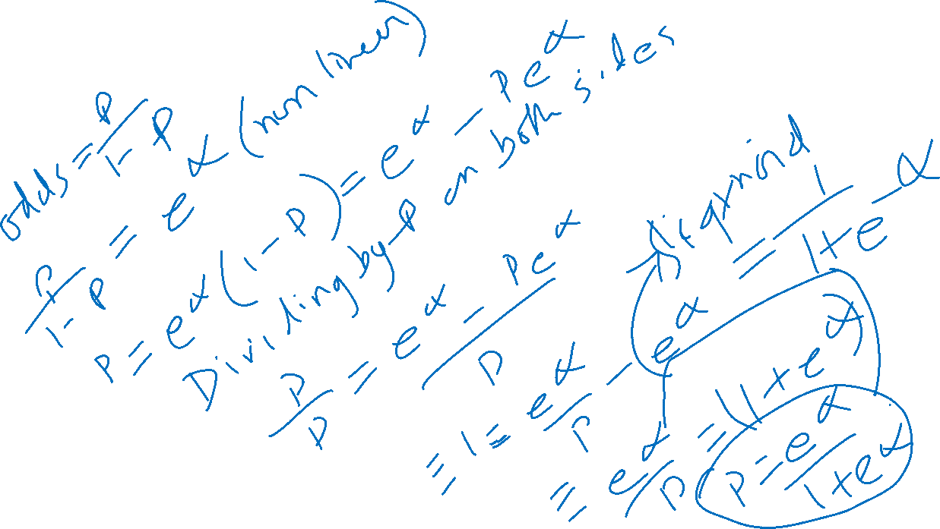

Slide 33
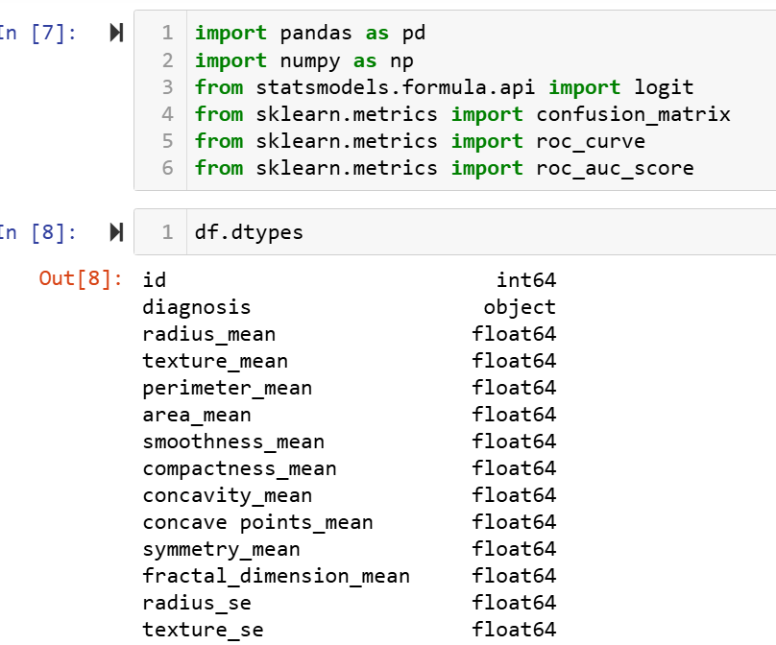

Slide 34
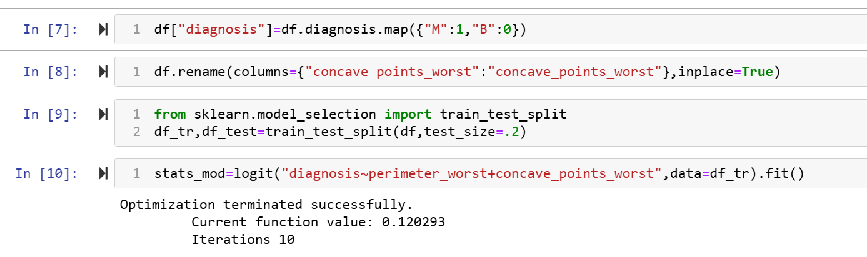

Slide 35
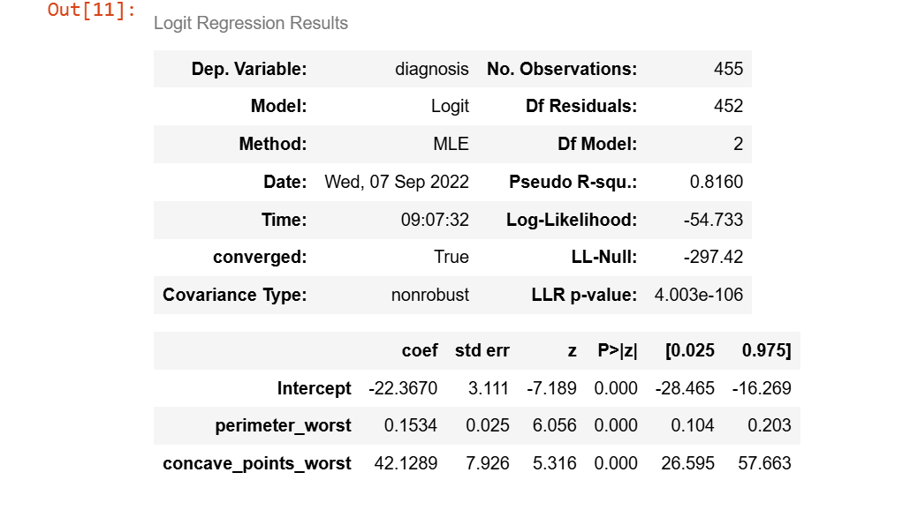

Slide 36
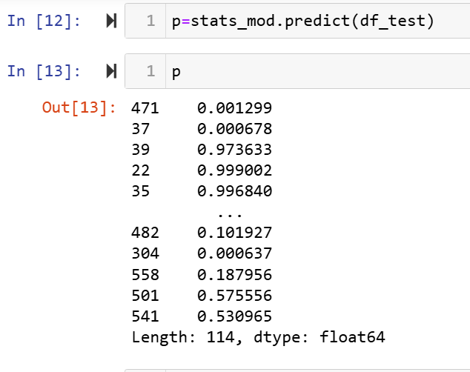

Slide 37
Confusion matrix
What is Confusion Matrix and why you need it?
Well, it is a performance measurement for machine learning classification problem where output can be two or more classes.
It is a table with 4 different combinations of predicted and actual values.

Slide 38
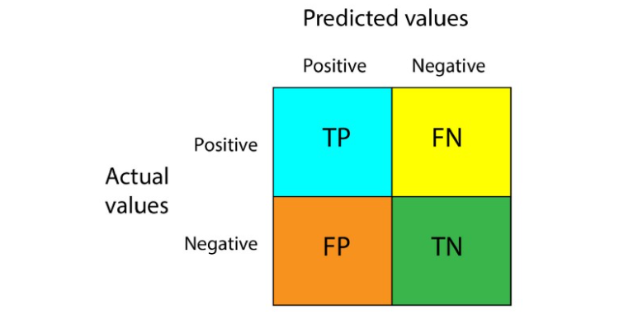

Slide 39
Understanding True Positive, True Negative, False Positive and False Negative in a Confusion Matrix
True Positive (TP)
The predicted value matches the actual value
The actual value was positive and the model predicted a positive value
True Negative (TN)
The predicted value matches the actual value
The actual value was negative and the model predicted a negative value

Slide 40
False Positive (FP) – Type 1 error
The predicted value was falsely predicted
The actual value was negative but the model predicted a positive value
Also known as the Type 1 error
False Negative (FN) – Type 2 error
The predicted value was falsely predicted
The actual value was positive but the model predicted a negative value
Also known as the Type 2 error

Slide 41
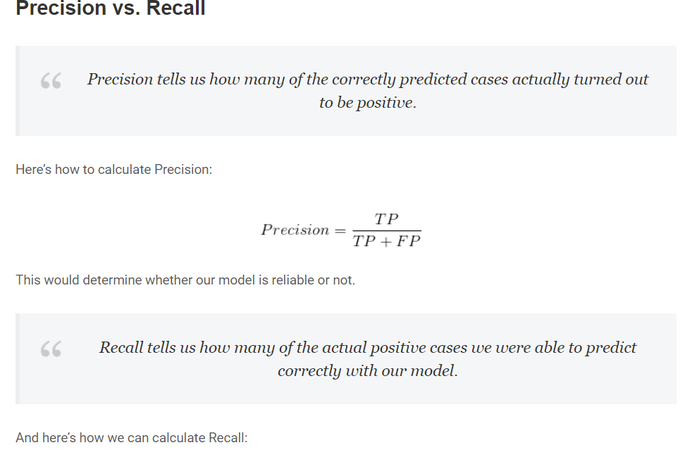
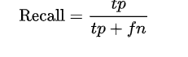

Slide 42
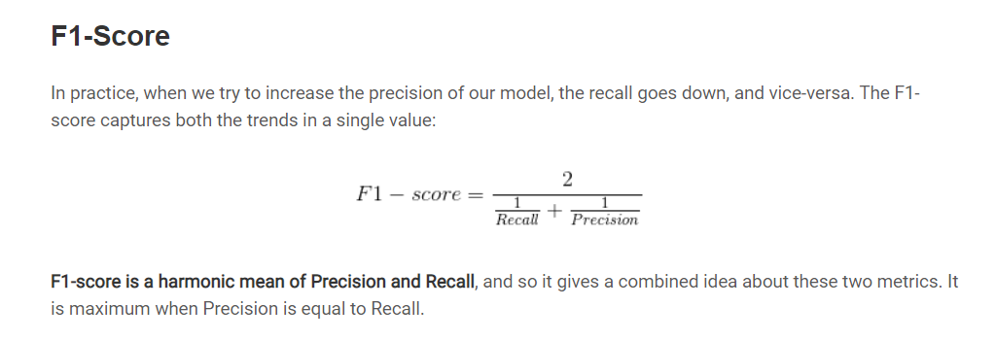

Slide 43

Introduction to AI

Slide 44
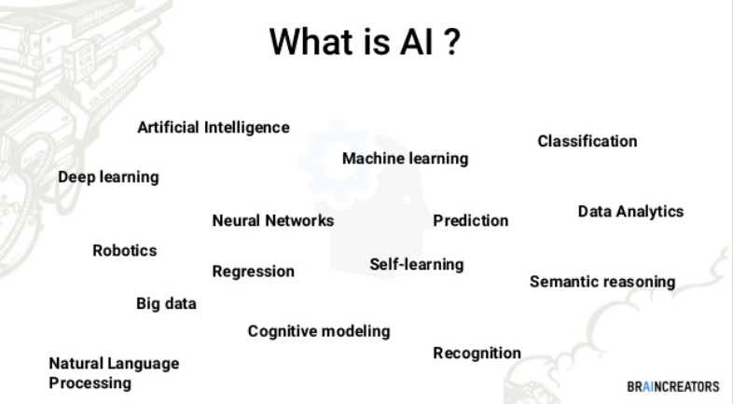

Slide 45

Intelligence
The intelligence is intangible. It is composed of
Reasoning
Learning
Problem Solving
Perception
Linguistic Intelligence

Slide 46

Neural networks
Neural networks are simulation of biological neurons.
Similar to dendrites in biological neurons, channels of data are responsible for carrying data between neurons.
The strength of these channels is referred to as the weights associated with them.

Slide 47
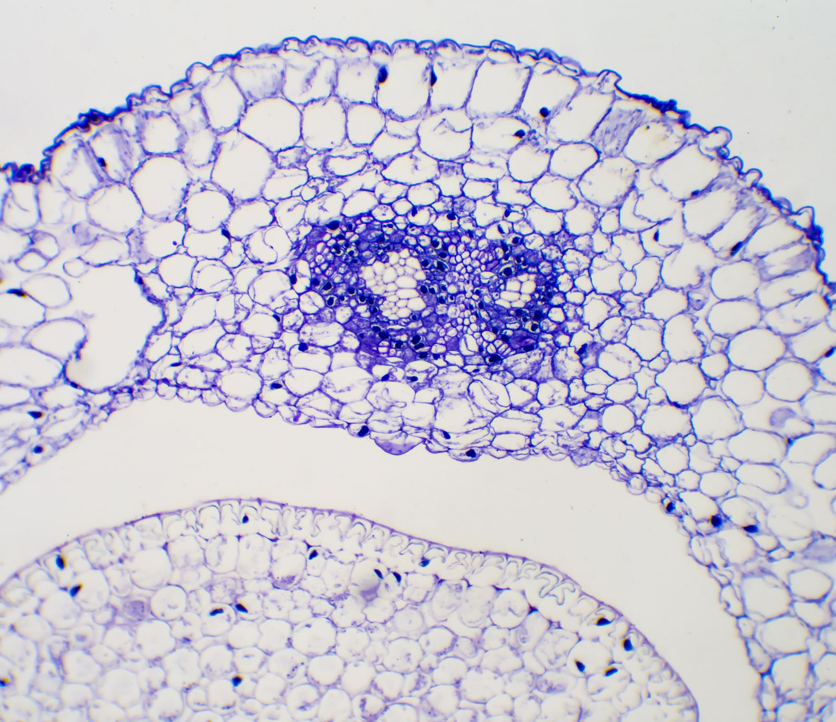
Neurons has 3 parts
Dendrites : Act as the channel that gets signals to cell body with their strength as weights
Cell Body : Collects input through dendrites and processes to produce output
Axon : Responsible for transmitting signals to other neurons

Slide 48
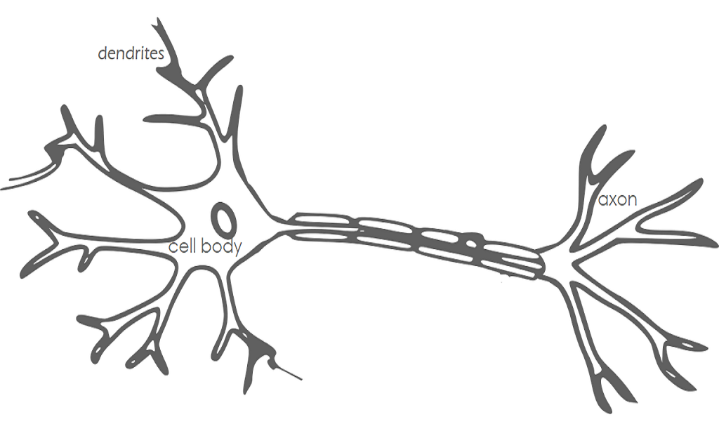

Slide 49
Simplest Neural Network
An Artificial Neuron is a simple model developed with approximation of a biological neuron in 1940.
It uses a threshold function to produce an output of either 0 or 1 and act as a classifier.
This model has fixed weights and does not learn.
This is the most simplest neural network from a biological perspective.

Slide 50
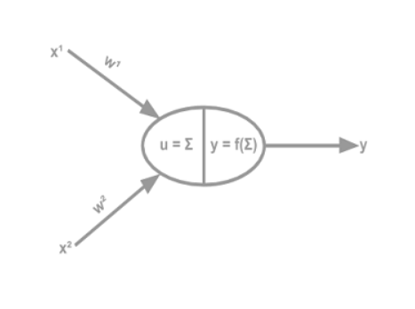
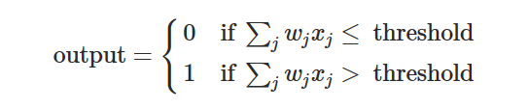
Perceptrons
A perceptron takes several binary inputs,
x1,x2
and produces a single binary output:

Slide 51
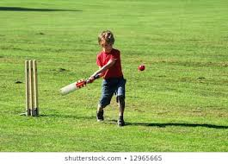
Decision to go out and play
You are trying to decide whether or not to go to play outside. You might make your decision by weighing up three factors:
Is the weather Sunny?
Is it Windy?
Is it humid
We can represent these two factors by corresponding binary variables
x1,x2,x3

Slide 52
Binary condition
For instance, we'd have
x1=1 if the weather is Sunny, and x1=0 if the weather is rainy or cloudy.
Similarly, x2=1,if its not windy, and x2=0 if its windy. ,
if its humid x3=1,x3 =0 if its not

Slide 53
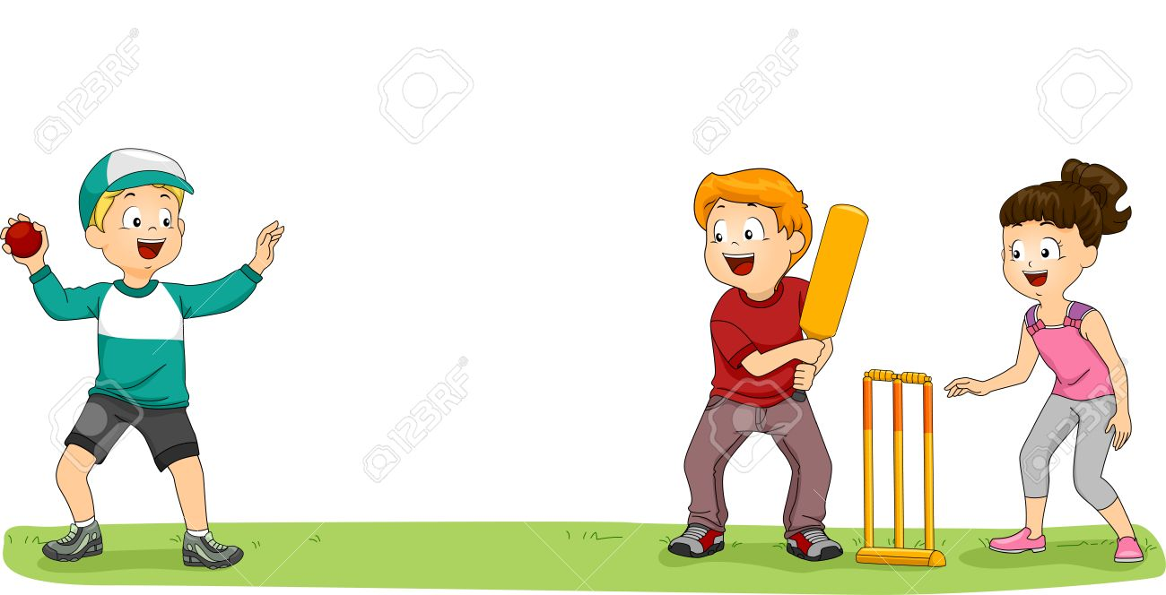
Calculating the threshold
One way to do this is to choose a weight w1=2 for the weather, and w2=4 for windy, w3=1 for the humid conditions.
The larger value of w2 indicates that the windy matters a lot to me.
Now choosing a threshold of 6 indicates that
weather has to be sunny and not windy and humidity doesn’t matter
or weather not windy and humidity is high still we go to play.

Slide 54
Combinations
weather | Not Windy | Humidity
2 | 4 | 1
Sunny,not windy, high humidity = 2*1+4*1+1*1=7(play)
Rainy,windy,High humity=0+4*0+1*1=1(no play)
Sunny,not Windy,low humidity=2+4+0=6(play)
Rainy,not windy,high humidity=2*0+4*1+1*1=5(no play)

Slide 55
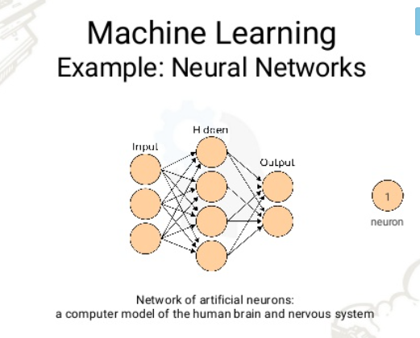

Slide 56
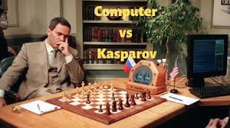
Deep Blue versus Garry Kasparov was a pair of six-game chess matches between world chess champion Garry Kasparov and an IBM supercomputer called Deep Blue.
The first match was played in Philadelphia in 1996 and won by Kasparov.
The second was played in New York City in 1997 and won by Deep Blue.
Deep blue design was based on Artificial intelligence and reinforcement learning

Slide 57
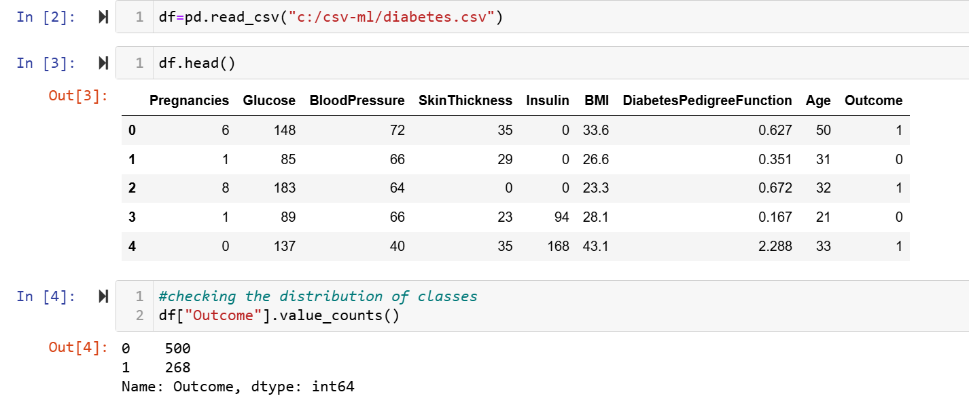

Slide 58
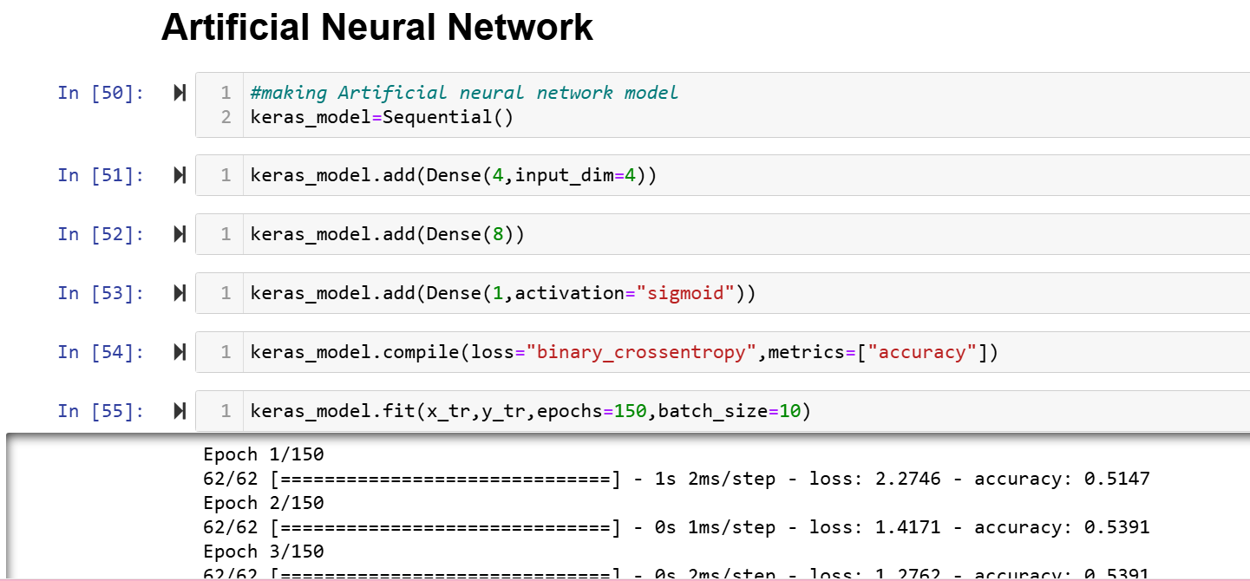

Slide 59
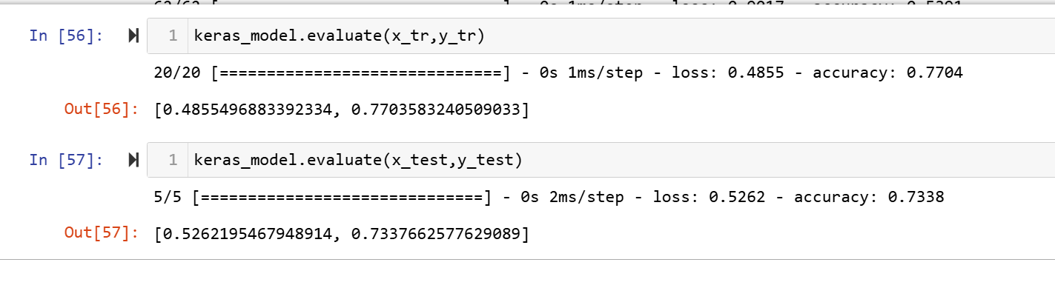
Prediction and accuracy

Slide 60
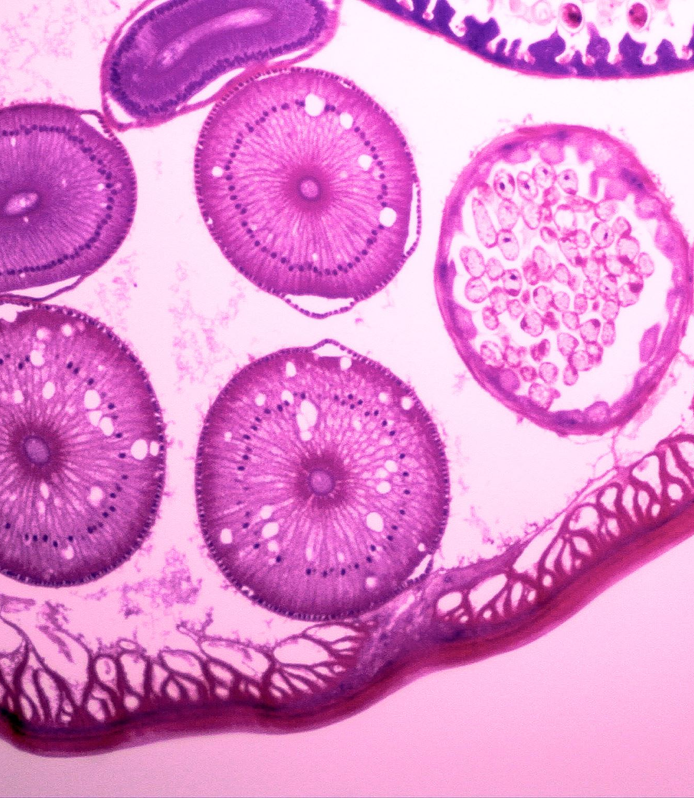
Dectection of a disease from biomedical image

Slide 61
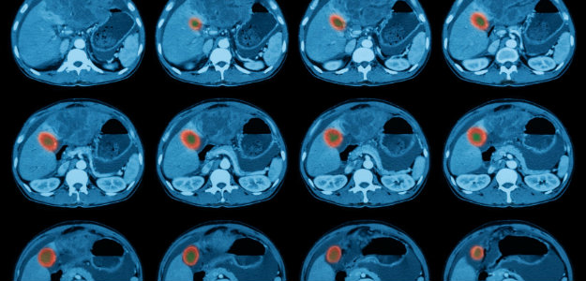
Types of biomedical images
CT scan
PET
MRI
XRAY
ultrasound

Slide 62
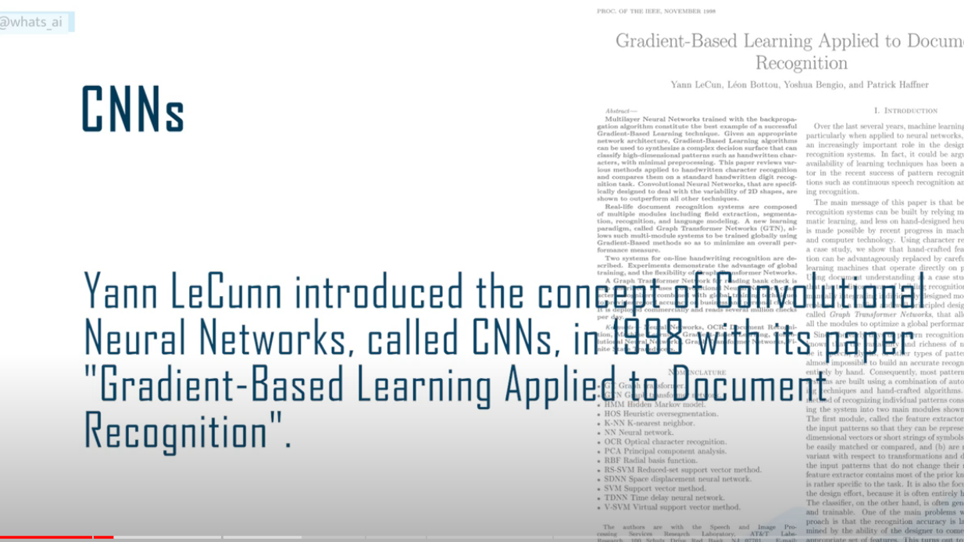

Slide 63
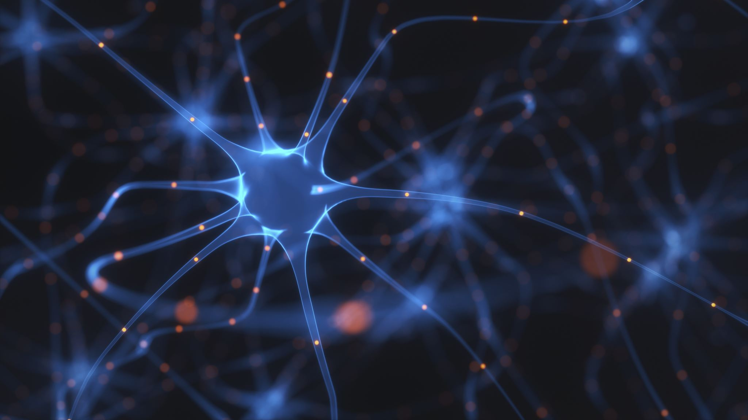
Convolutional Neural Network

Slide 64
CNN
A Convolutional Neural Network (CNN) is a type of Deep Learning neural network architecture commonly used in Computer Vision.
Computer vision is a field of Artificial Intelligence that enables a computer to understand and interpret the image or visual data.

Slide 65
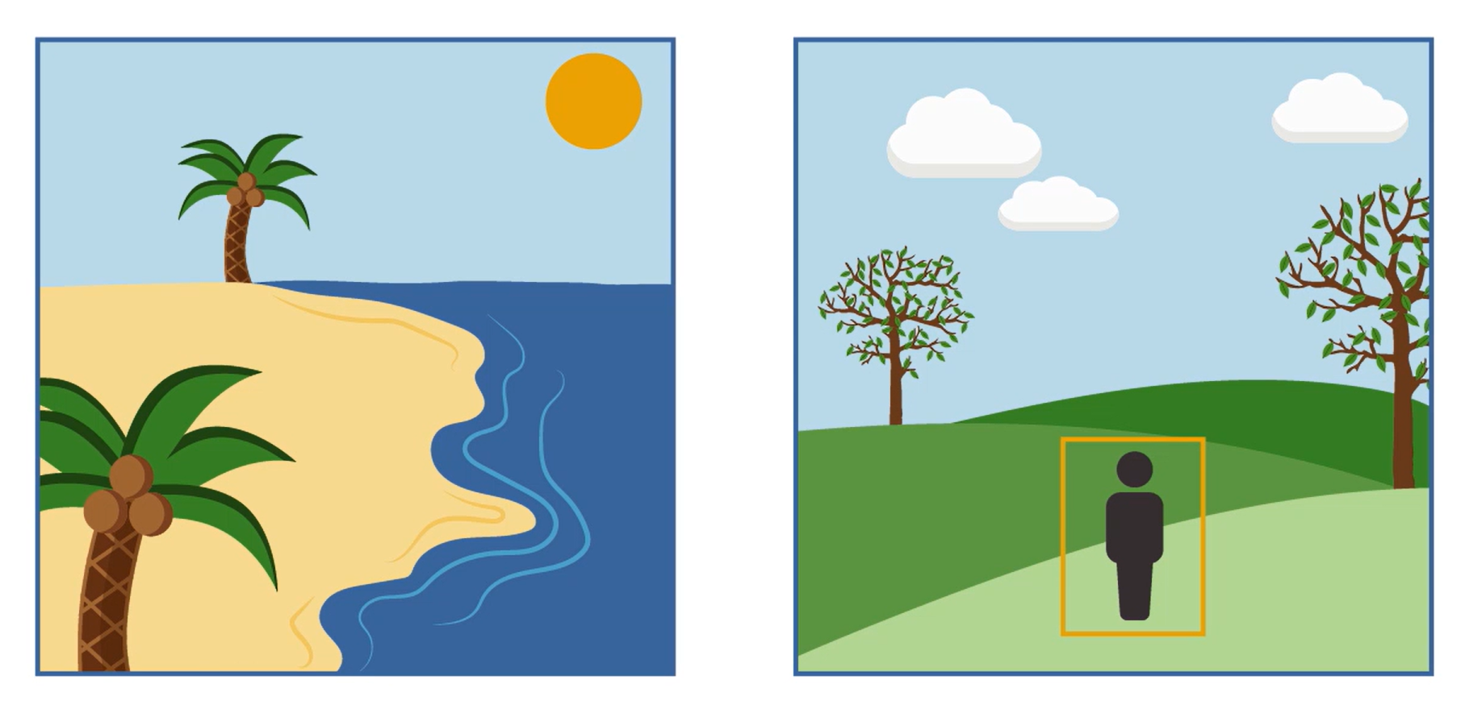
Object detection
Segmentation
Image processing

Slide 66

Image classification
CAT

Slide 67
ImageNet Challenge:
ImageNet is formally a project aimed at (manually) labeling and categorizing images into almost 22,000 separate object categories for the purpose of computer vision research.
The ImageNet Large Scale Visual Recognition Challenge, or ILSVRC for short.
The goal of this image classification challenge is to train a model that can correctly classify an input image into 1,000 separate object categories.

Slide 68


Slide 69

Typical neural network

Slide 70

Convolutional neural network

Slide 71

How CNN recognizes image

Slide 72
Layers in a Convolutional Neural Network
A convolution neural network has multiple hidden layers that help in extracting information from an image. The four important layers in CNN are:
Convolution layer
ReLU layer
Pooling layer
Fully connected layer

Slide 73

CNN

Slide 74

Convolution layer

Slide 75


Slide 76

Sliding window filter

Slide 77

convolution

Slide 78

Convolution Layer
This is the first step in the process of extracting valuable features from an image. A convolution layer has several filters that perform the convolution operation.
Every image is considered as a matrix of pixel values.
Consider the following 5x5 image whose pixel values are either 0 or 1. There’s also a filter matrix with a dimension of 3x3.
Slide the filter matrix over the image and compute the dot product to get the convolved feature matrix.

Slide 79


Slide 80

Kernel operation for grayscale images

Slide 81

Vertical edge detection example

Slide 82

Convolve the image with a 3x3 filter

Slide 83

Output feature map

Slide 84

Vertical and horizontal edge detection

Slide 85

Activation functions in CNN

Slide 86
When to apply activation functions
In a CNN, activation functions are typically applied after each convolutional layer and fully connected layer.
However, they are not applied after pooling layers.
The purpose of using activation functions after the convolutional and fully connected layers is to introduce non-linearity into the model after performing linear operations (convolution and matrix multiplication).
In essence, activation functions serve as the “switch” in artificial neurons that decide whether that neuron should be activated or not based on the weighted sum of the input.

Slide 87

WHAT IS THE RELU ACTIVATION FUNCTION?
An activation function is also commonly applied during feature map generation to constrain output pixels to a certain range.
a common choice is the Rectified Linear Unit (ReLU) function that passes through only positive values to the feature map and sets all negative pixels to zero.

Slide 88

RELU
In simple terms, this can also be written as follows:
if input > 0:
return input
else:
return 0

Slide 89

Sigmoid Function
It is a function which is plotted as ‘S’ shaped graph.
Equation : A = 1/(1 + e^{-x})
Nature : Non-linear. Notice that X values lies between -2 to 2, Y values are very steep. This means, small changes in x would also bring about large changes in the value of Y.
Value Range : 0 to 1
Uses : Usually used in output layer of a binary classification,
where result is either 0 or 1, as value for sigmoid function lies between 0 and 1 only so,
result can be predicted easily to be 1 if value is greater than 0.5 and 0 otherwise.

Slide 90
Softmax Function
The softmax function is also a type of sigmoid function but is handy when we are trying to handle multi- class classification problems.
Nature :- non-linear
Uses :- Usually used when trying to handle multiple classes. the softmax function was commonly found in the output layer of image classification problems.
The softmax function would squeeze the outputs for each class between 0 and 1 and would also divide by the sum of the outputs.
Output:- The softmax function is ideally used in the output layer of the classifier where we are actually trying to attain the probabilities to define the class of each input.

Slide 91
Pooling (Downsampling)
​The next step, pooling, shrinks the size of each feature map by 75% or more.
This allows only the most important features to be retained, thus reducing the number of learnable features of the model. With fewer parameters, pooling helps prevent overfitting of data.

Slide 92


Slide 93

Maxpooling is used to reduce computational cost
Reduces number of parameters
2x2 filter is used
The image is divided into 2x2 square regions
Max number from this region is written to output image
Reduces overfitting

Slide 94

Activation function(feature selection) and pooling(dimension reduction)

Slide 95


Slide 96
Convolution, Activation, and Pooling ..... Repeat
The convolution-pooling process may be repeated several times, producing ever smaller "feature of feature" maps.
Pooling is not always performed after each convolution; in some networks several convolutions are performed followed by a pooling step.

Slide 97


Slide 98
Final Processing Steps
Many possibilities exist once the multiple convolution-pooling process is complete.
One common final stage, known as vectorization or flattening,
converts the last 2-dimensional feature maps into a single long chain of numbers (i.e., a "vector").
The vectorized feature maps then serve as inputs into a fully connected neural network whose output can be used to produce a final "decision" (such as tissue segmentation or disease classification).

Slide 99
Flattening
The next step in the process is called flattening.
Flattening is used to convert all the resultant 2-Dimensional arrays from pooled feature maps into a single long continuous linear vector.

Slide 100


Slide 101


Slide 102

Training from scratch

Slide 103

Transfer learning

Slide 104


Slide 105

Dataset

Slide 106

Training images dataset

Slide 107


Normal chest XRAY
Chest XRAY with pneumonia

Slide 108


Slide 109


Slide 110


Slide 111


Slide 112

Training the CNN

Slide 113

Prediction

Slide 114

Detecting the presence of an object in patient’s body

Slide 115
What is Object Detection ?
Object detection, within computer vision, involves identifying objects within images or videos. These algorithms commonly rely on machine learning or deep learning methods to generate valuable outcomes.

Slide 116


Axial MRI of a brain
Healthy brain
Brain with tumor

Slide 117

Brain tumor localization bounding box

Slide 118


Slide 119


Slide 120
Steps of object detection
Looking at the Picture: Imagine a computer looking at a picture.
Finding Clues: The computer looks for clues like shapes, colors, and patterns in the picture.
Guessing What’s There: Based on those clues, it makes guesses about what might be in the picture.
Checking the Guesses: It checks each guess by comparing it to things it already knows.
Drawing Boxes: If it’s pretty sure about something, it draws a box around it to show where it thinks the object is.
Making Sure: Finally, it double-checks its guesses to make sure it got things right and fix any mistakes

Slide 121
So broadly we have three tasks for object detection problems:
1. To identify if there is an object present in the image,
2. where is this object located,
3. what is this object?

Slide 122

Now let’s simplify this statement a bit with the help of the below image.

Slide 123

Bounding Box Evaluation – Intersection over Union (IoU) Scenario 1
So, consider the following scenario. Here we have two bounding boxes, box1 and box2.
Now if I ask you which of these two boxes is more accurate, the obvious answer is box1.

Slide 124

Scenario:- 2
Let’s consider another example suppose we have created multiple bounding boxes or patches of different sizes.

Slide 125

Area of union
Here, the intersection of the left bounding box is certainly 100% whereas, in the second image, the intersection of this predicted bounding box, or this particular patch is just 70%.
So at this stage, would you say that the bounding box on the left is a better prediction? obviously not. The bounding box on the right is more accurate.
So, to deal with such scenarios, we also consider the area of union, which is the patch area, as well as the actual bounding box area.

Slide 126

Range of IOU
from 0 to 1
The IoU value ranges from 0 to 1, where 0 indicates no overlap between the boxes, and 1 represents complete overlap or identical regions. Higher IoU values indicate greater similarity or agreement between the two bounding boxes.

Slide 127
NLP in Healthcare
Amazon Comprehend is a natural language processing (NLP) service that uses machine learning to analyze and find relationships in text.
It can be used for a range of use cases, such as: Customer sentiment analysis, Organizing documents based on topic, and Identifying key phrases from customer service call transcripts.

Slide 128
Prescription
Pt is 87 yo woman, highschool teacher with past medical history that includes
- status post cardiac catheterization in April 2019.
She presents today with palpitations and chest pressure.
HPI : Sleeping trouble on present dosage of Clonidine. Severe Rash on face and leg, slightly itchy.
Meds : Vyvanse 50 mgs po at breakfast daily,
Clonidine 0.2 mgs -- 1 and 1 / 2 tabs po qhs
HEENT : Boggy inferior turbinates, No oropharyngeal lesion.
Lungs : clear.
Heart : Regular rhythm.
Skin : Mild erythematous eruption to hairline.
Follow-up as scheduled

Slide 129


